Slide 1

12:34
12:39
12:49
12:52

Slide 4



Slide 5








Slide 8


Slide 9
Helsinki 12:30
http://www.fontspace.com/category/thin?p=2
http://www.fontspace.com/nimavisual/trench

Slide 10




Slide 11





Slide 14






Slide 15
M

Slide 16


Slide 17



Slide 18


Slide 19





Slide 20


Slide 25





Slide 26


Slide 27



Slide 38



Slide 39


Slide 40


Slide 41


Slide 44


Slide 45


Slide 46







Slide 47





Slide 48


Ewket Apps
®
Ewket Apps
®

Slide 49










Slide 50



Slide 51



Slide 53
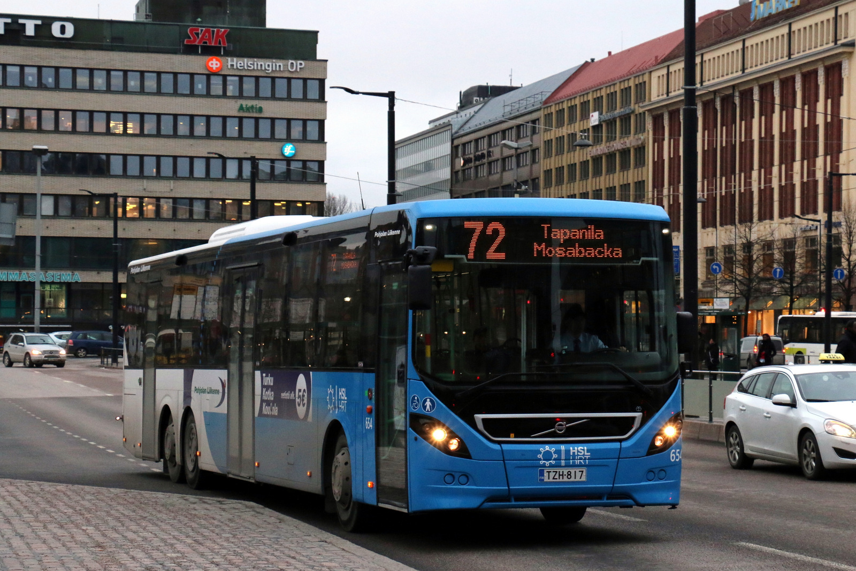

Slide 54


Slide 55
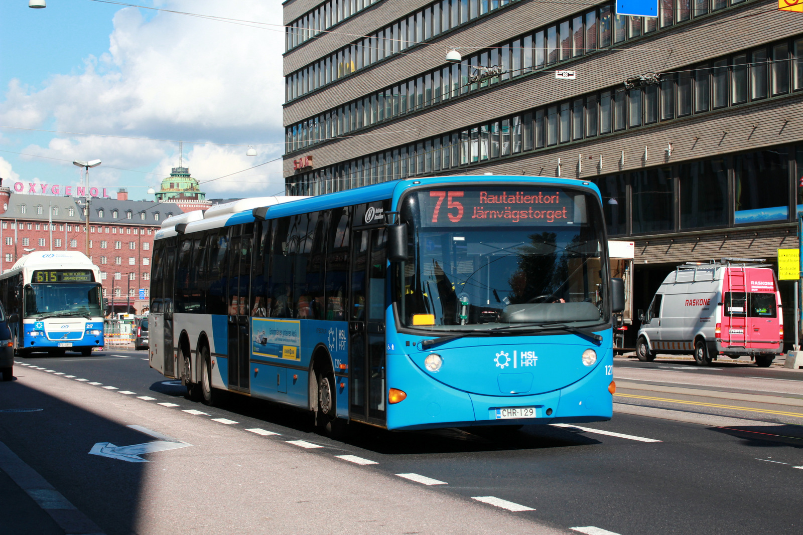

Slide 56


Slide 57


Slide 59
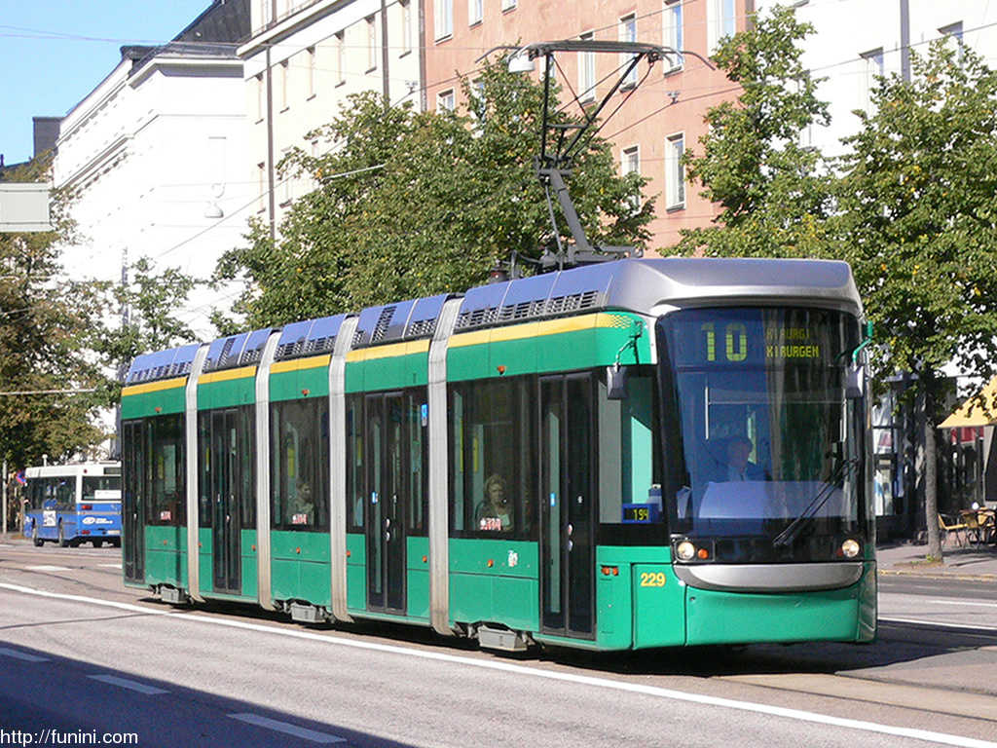

Slide 61


Slide 62
C
B
A - > C
B -> X
X = (b * C)/A
Dif = (A – B)/2
A
C * (1 – B/A)/2

